Slide 1

SPAG expectations
Spelling, punctuation and grammar -
What does this entail for Y6 SATs?

Slide 2
What do we know about adverbials?
- an adverbial is a word or phrase functioning as part of a clause and typically expressing time, place or manner

Slide 3
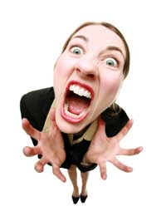
Adverbs of manner
Adverbs of manner are used to tell us the way or how something is done. An adverb of manner usually modifies a verb.
The lawyer started to shout.
The lawyer started to shout ______________________.
uncontrollably enthusiastically demonically maniacally passionately competitively furiously hilariously incomprehensibly

Slide 4
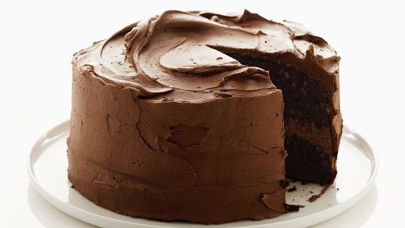
Adverbials of time
Adverbials of time express the frequency of an action. Adverbials of time are usually placed before the main verb or clause that they modify.
We baked an impressive cake.
___________________________ we baked an impressive cake.
yesterday last week/month/year today
last Saturday next Friday tomorrow
next week/month/year this morning last night

Slide 5
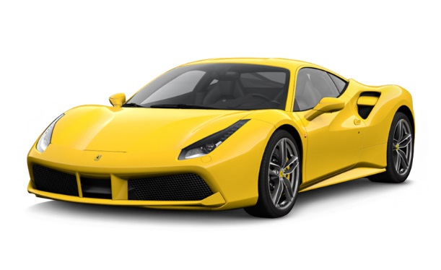
Adverbials of place
Adverbials of place tell us where something happens. Adverbials of place are usually placed after the main verb or after the clause that they modify.
A Ferrari was accelerating.
A Ferrari was accelerating __________________.
nearby outside over there
everywhere behind us downstairs below
upstairs elsewhere ahead beyond

Slide 6
Challenge - Give an example of an ‘ly’ word which is an adjective rather than an adverb of manner
lovely lonely motherly
friendly neighbourly kindly

Slide 7

Billy’s legs turned to jelly. He was petrified of the witch.
How could you join these two sentences to make one long sentence?
Which word would be most suitable to join these together?
Challenge – How could you rearrange the words in this new sentence so that it begins in a different way? Would you need to add or change any punctuation and why?

Slide 8

What is a conjunction?
A conjunction is like the glue that links two or more words, phrases or clauses together.
There are two main types of conjunctions we use within sentences.
co-ordinating conjunctions
subordinating conjunctions

Slide 9
co-ordinating conjunctions
(e.g. and) link two main clauses together as an equal pair to create a compound sentence.
We usually remember these words using the acronym ‘FANBOYS’.

Slide 10
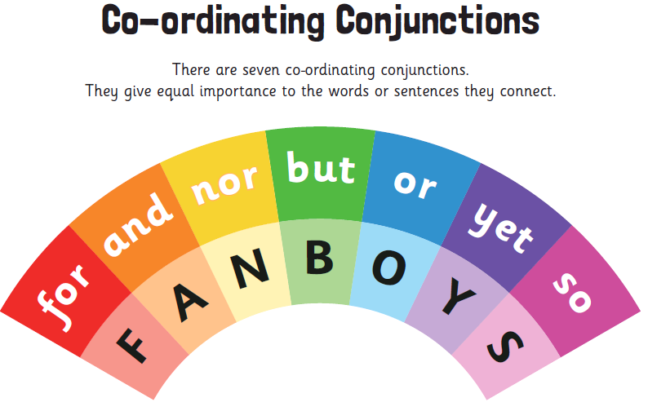

Slide 11
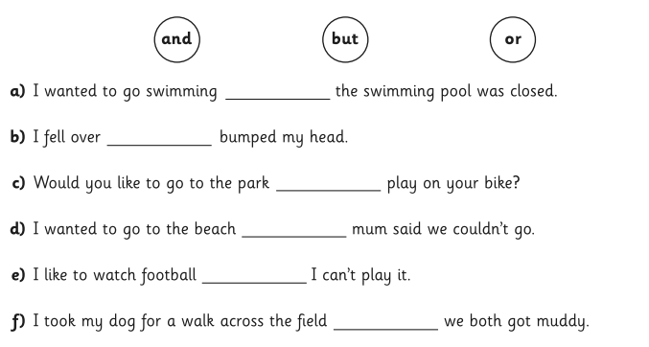
Task : Co-ordinating conjunctions

Slide 12
subordinating conjunctions
(e.g. when) introduce a subordinate clause.
You can remember some of the most useful subordinating conjunctions by using the acronym ‘AWHITEBUS’

Slide 13
So, how do we use subordinating conjunctions?
Subordinating conjunctions are the first words within a subordinate clause. Subordinate clauses do not make sense on their own.
Subordinate clauses will always have a subject and verb within them, e.g.
after she smiled
after Christmas
subordinating conjunction
subject
verb
Here ‘after’ is being used as a preposition.
is a subordinate clause
is not a subordinate clause

Slide 14
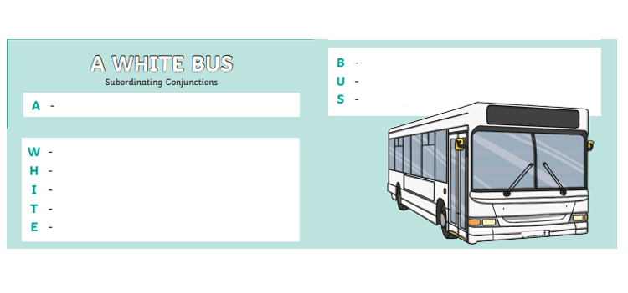

Slide 15
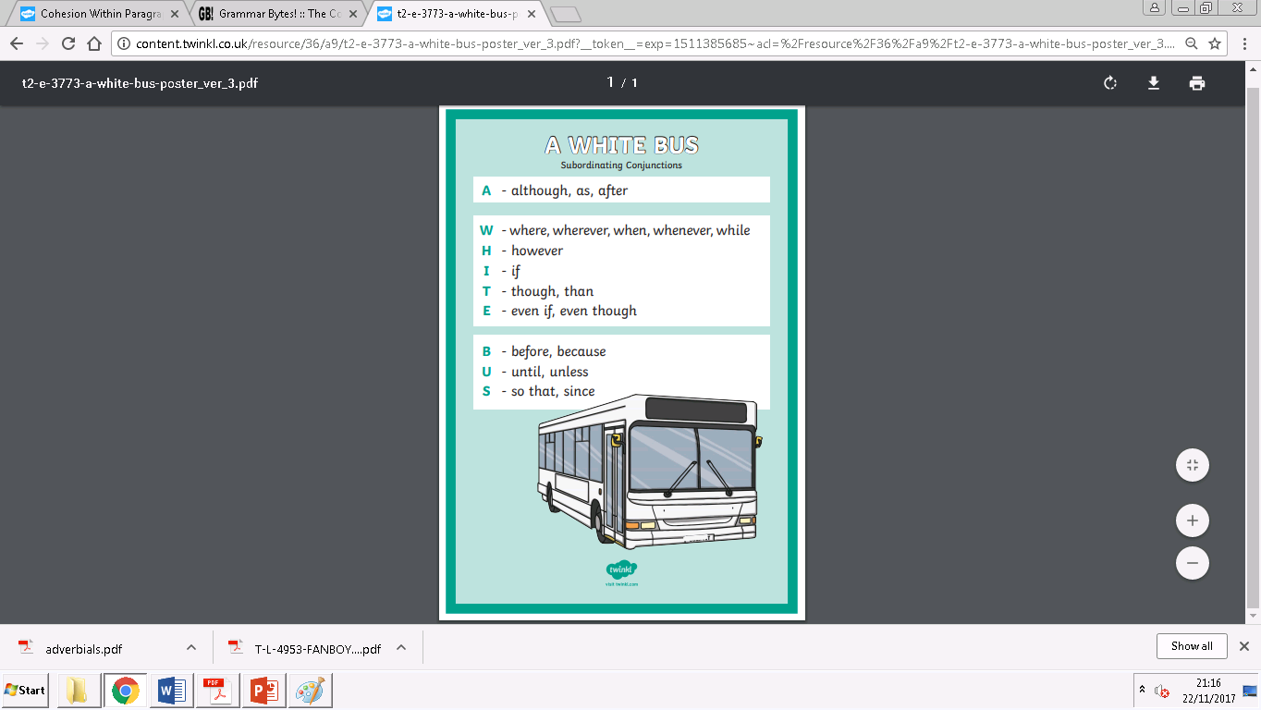

Slide 16
